Slide 1

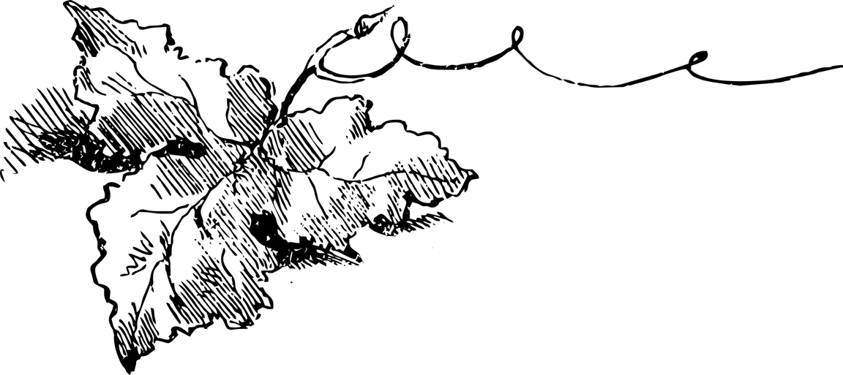
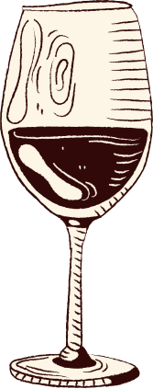

DataVine 12 Vineyard
Wine
Tasting
Our Vintners:
Alma Ontiveros, Charisse Robinson, Chorrkin Chin, Donald Sparks III, Erika Dorsainvil, Kidest Getahun, Magdalene Alva, Maya Morad, Mica Lorenzo, Mita Damte, Patrick Feeney, and Rob Jowaisas.

Slide 2
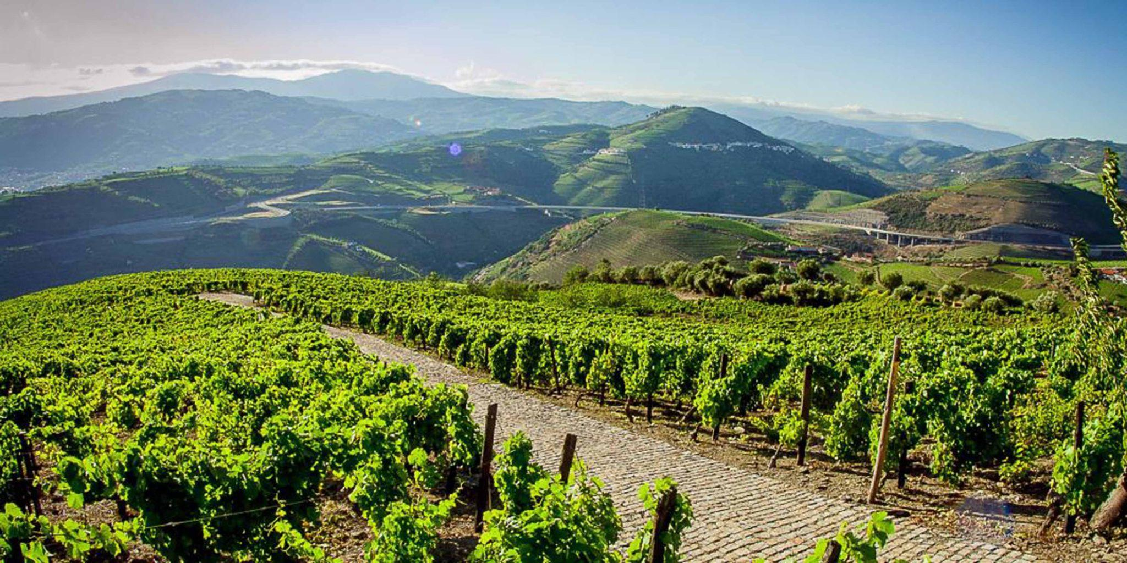
Produced in Portugal
Portugal is home to more than 250 indigenous grape varieties, making it one of the world’s top 10 producers of wine.

Slide 3



On Today’s Menu
01
Our History
02
Our Team’s Mission
03
Chemical Properties
The History of the DataVine 12 Winery
Explains the goal of our project
Factors that contribute to the flavor, aroma, and color of wine

Slide 4
On Today’s Menu
04
The Process
05
Visualizations
06
Contact Us
Explains the data cleaning process and models used
Visualizied models in Tableau
(or not) DataVine 12 will be closed starting April 10 until next harvesting season

Slide 5
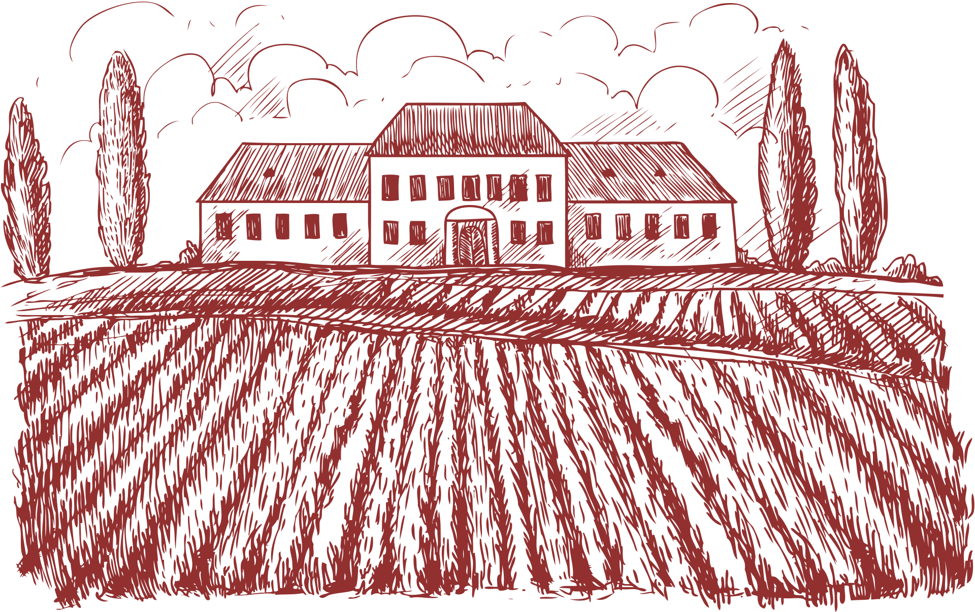
Our History
FoundedOct. ‘24
April’25
DataVine 12
Winery
DataVine 12 Partners
Starting April 10, the winery will be closed to all guests until the next harvesting season
all met online

Slide 6


Our Team’s Mission
The goal of DataVine 12 was to figure out if we can predict wine quality based on its chemical properties?
Wines: Portuguese Reds & Whites
Compared based on fixed and volatile acidity, citric acid, residual sugar, chlorides, free sulfur dioxide, density, pH, sulfates, and alcohol to then determine quality

Slide 7

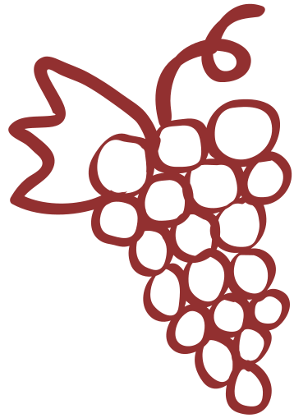


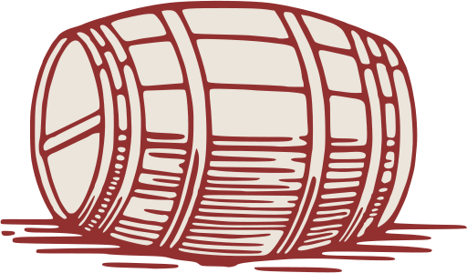
chemical Properties of wine
Fixed/Volatile Acidity
pH
Sulfates
Free Sulfur Dioxide
Scaled: 0-14
0= Very acidic
14=Very basic
Most wines are between 3-4 on the pH scale ;
A wine additive that can contribute to sulfur dioxide gas (S02) levels, which acts as an antimicrobial and antioxidant
The free form of SO2 exists in equilibrium between molecular SO2 (as a dissolved gas) and bisulfite ion
Volatile Acidity-the measure of a wine’s gaseous acids. Contributes to the smell and tastes like vinegar
Fixed Acidity-aka tartaric acid. Doesn’t readily evaporate
Also influences stability and shelf life
Prevents microbial growth and the oxidation of wine

Slide 8
chemical Properties of wine
Citric Acid
Chlorides/ Alcohol
Residual Sugar
Density
The amount of sugar remaining in the wine after fermentation stops
(In terms of water)
depending on the percent alcohol and sugar content
(Alcohol is lighter than water. Density decreases with increased alcohol presence.)
Found in small quantities
Citric acid can add ‘freshness’ and flavor to wine
The amount of salts in wine
it’s rare to find wines with less than 1 gram/liter and wines with greater than 45 grams/liter are considered sweet
Alcohol-the percent alcohol content of the wine

Slide 9
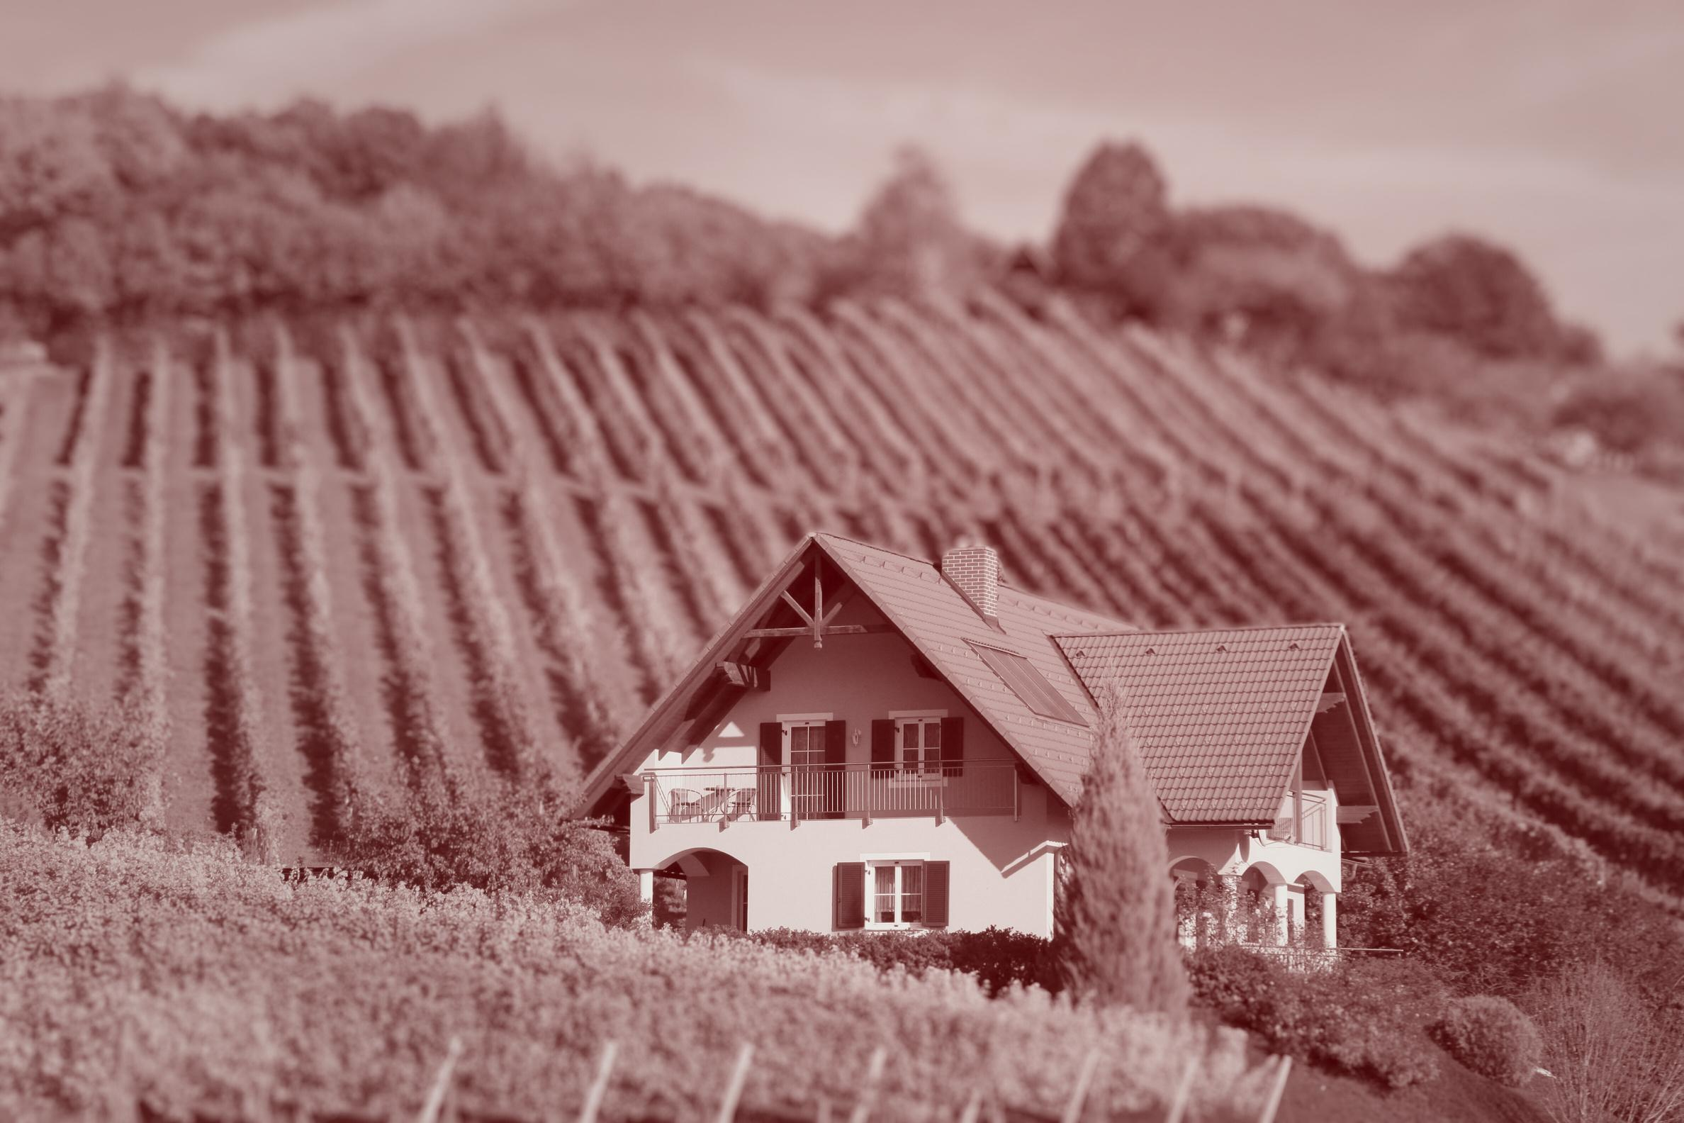

Wine Quality Prediction Using Supervised Learning
• Classification: Standard vs. Premium
• Dataset: Merged Red and White Wines
• Tools: Python, Spark SQL, Scikit-learn
Notes:
Hello Everyone, Donald and I worked to create a notebook that focuses on predicting whether a wine is Standard or Premium based on its chemical properties. We merged red and white wine datasets and used supervised learning techniques to train models that classify wines efficiently based on data. This type of approach can improve consistency in wine production and help consumers find better wine choices with greater consistency and accuracy

Slide 10
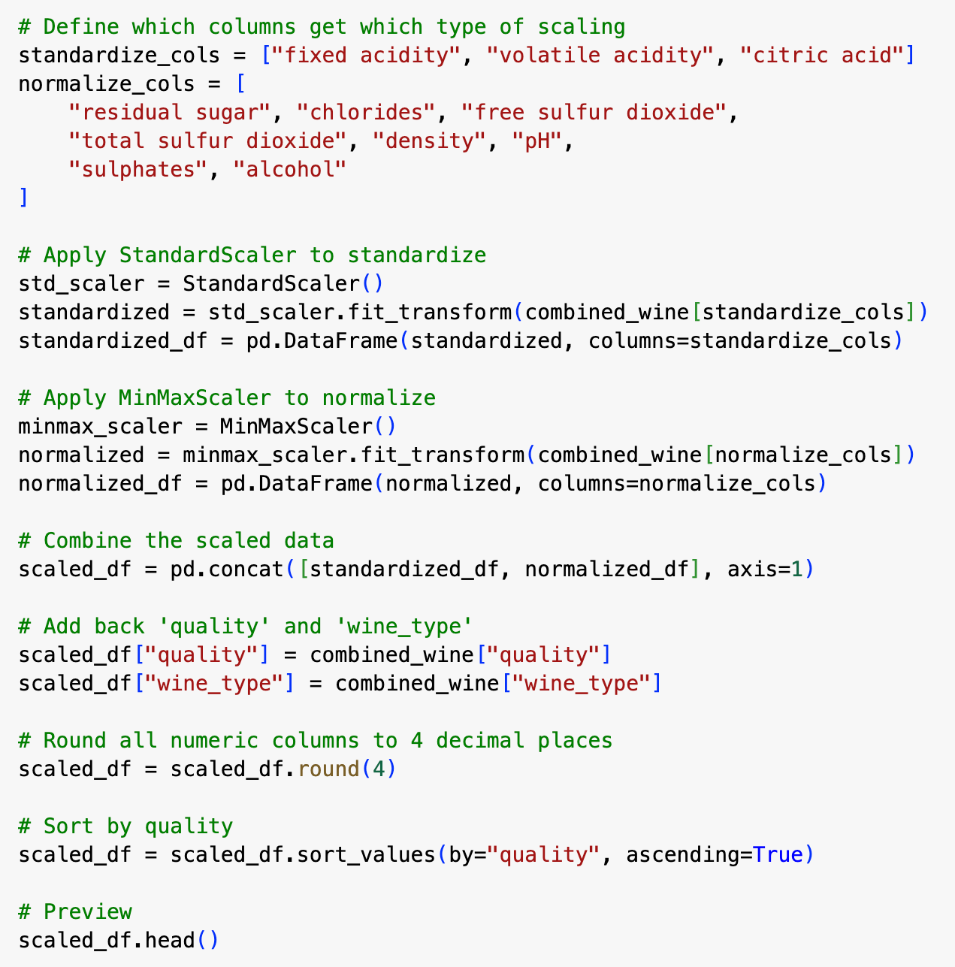
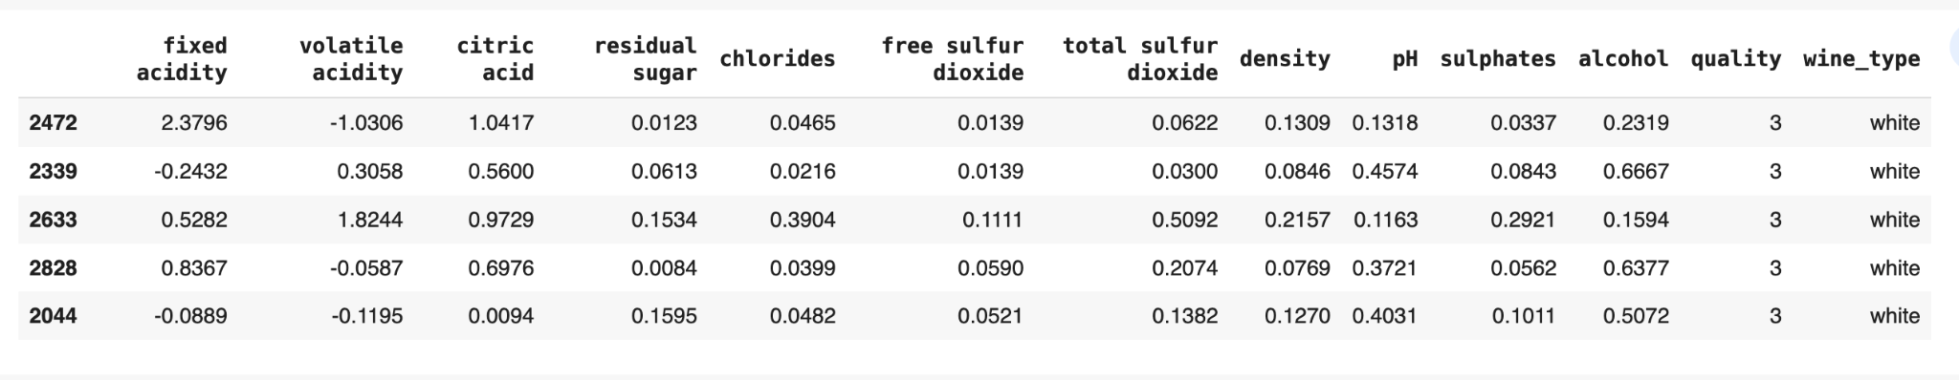
Data Cleaning & Feature Engineering
• Merged two datasets (Red & White)
• Removed nulls and standardized feature types
• Applied feature scaling (standardization + normalization)
• Saved as cleaned_wine_data_with_scaling.csv
Notes:
We started with two separate datasets, one for red wine and one for white. We merged them and ensured there were no missing values. To prepare for modeling, we applied scaling techniques: standardization for some features and normalization for others. This step is critical for helping models perform consistently across all features.

Slide 11
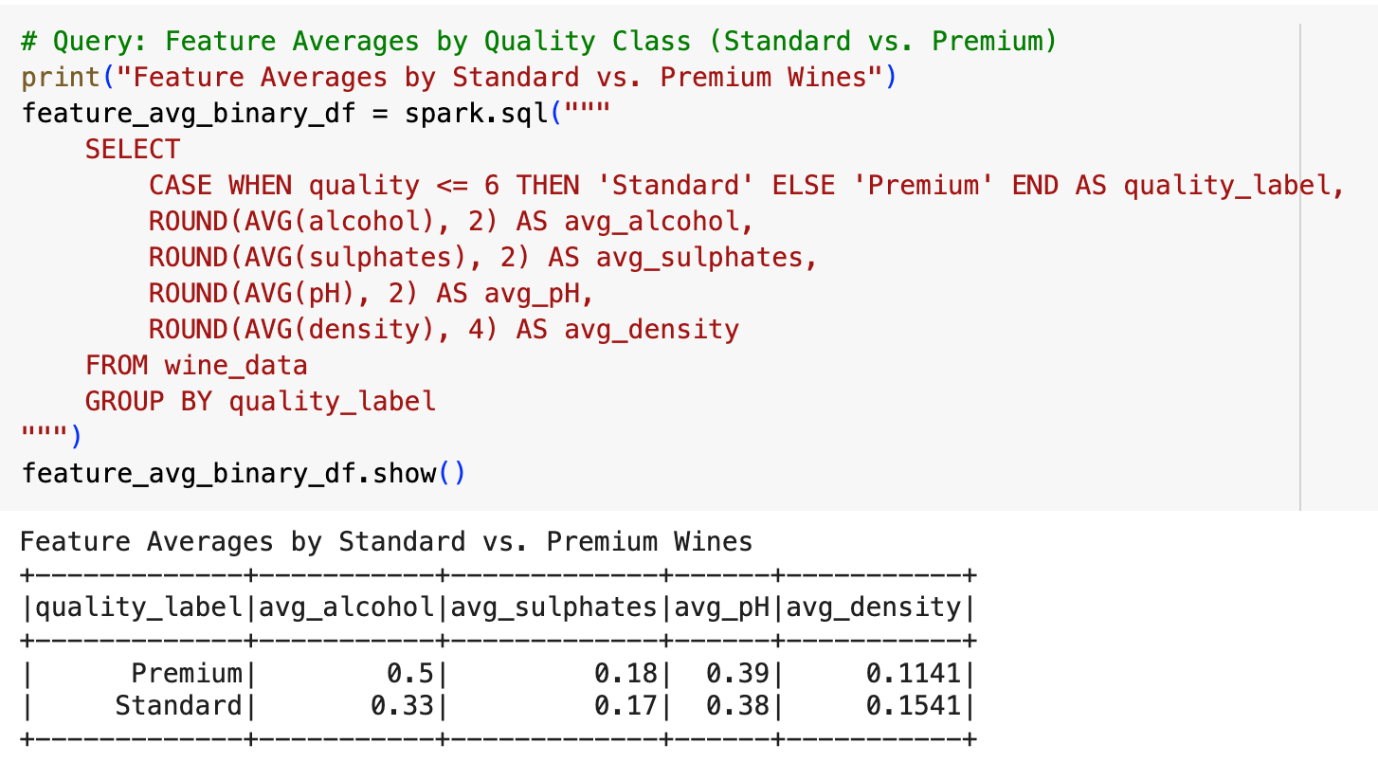
Spark SQL Analysis
• White wines scored slightly higher on average
• Premium wines had higher alcohol and lower density
• Spark SQL confirmed strong feature patterns before modeling
Notes:
We used Spark SQL to group the wines into our two quality classes: Standard and Premium and we were able to spot clear differences in chemical properties. Premium wines generally had higher alcohol content and lower density, which reinforces their importance as key features in our model. Sulphates and pH showed smaller differences, but still added useful signals that supported our classification approach.

Slide 12
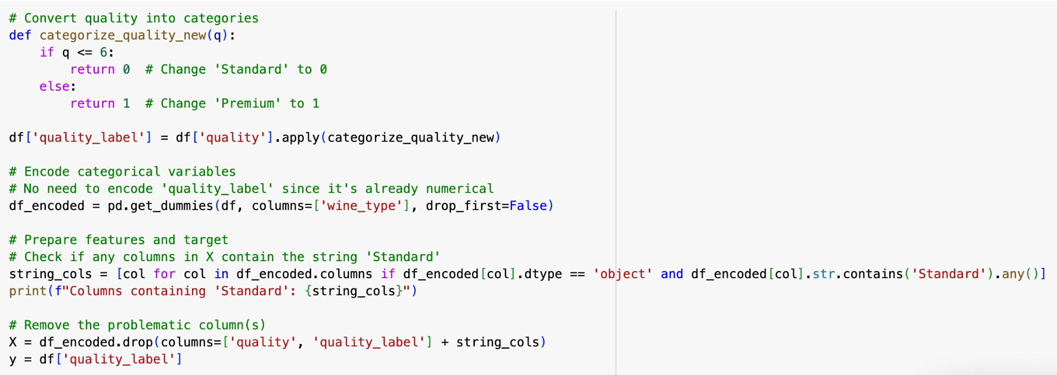
Model Preparation & Label Binning
• Quality scores converted to two labels: Standard (≤ 6), Premium (> 6)
• Target labels created using a custom function
• Categorical features (like wine type) one-hot encoded
• Scaled features used as input for ML models
Notes:
We simplified the wine quality scores into two categories: Standard for wines with a score of 6 or below, and Premium for scores above 6. We created this target using a custom function and then encoded other categorical features, like wine type, using one-hot encoding. Once the data was labeled and fully numeric, we were ready to train our machine learning models using the scaled chemical features.

Slide 13
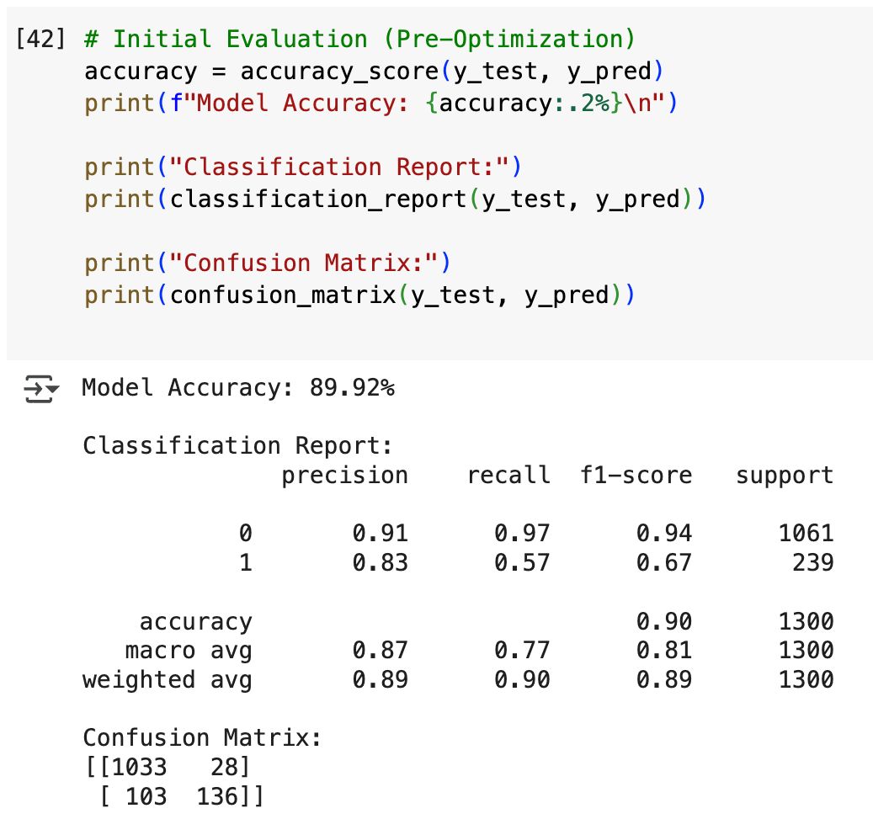
Initial Model Training
• Used Random Forest Classifier as the baseline model
• Train/test split: 80% training, 20% testing
• Target: Predict Standard vs. Premium wines
• Initial accuracy: 89.92% (pre-optimization)
Notes:
Before any optimization, we trained a Random Forest Classifier as our baseline model. We used an 80/20 train-test split and set our target to classify wines as either Standard or Premium. The initial results were really promising, the model achieved almost 90% accuracy even before tuning, which gave us a strong foundation to build on.

Slide 14
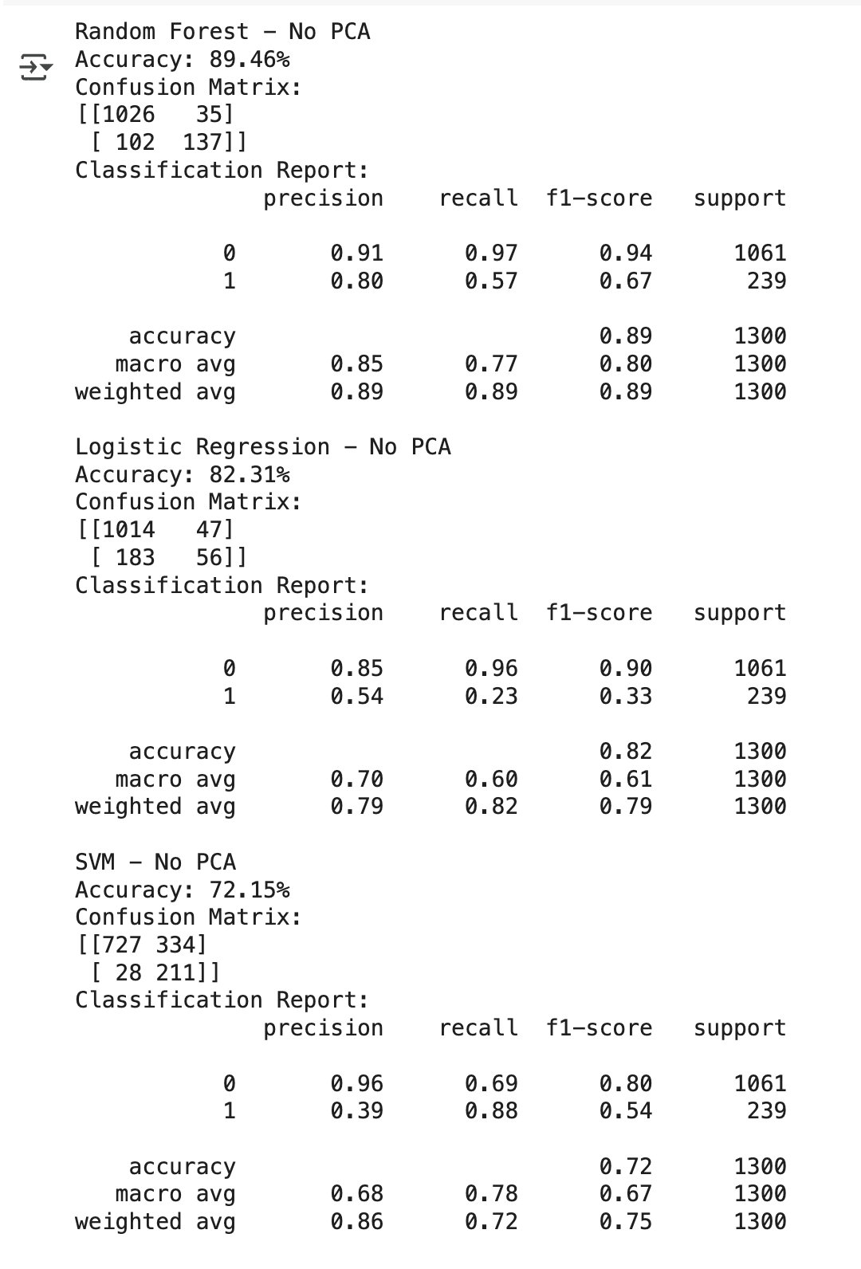
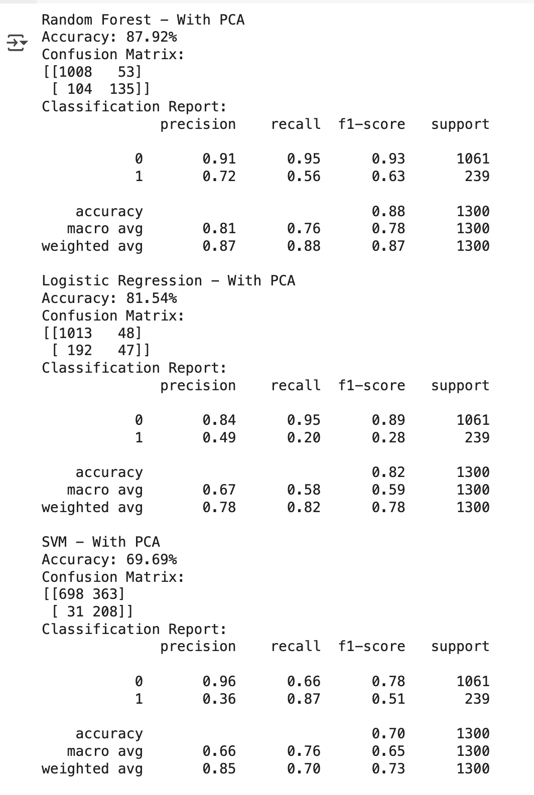
Model Optimization
• Models: Random Forest, Logistic Regression, SVM
• Trained with full features and PCA-reduced features
• PCA used to reduce dimensionality and simplify input
• Compared results with and without PCA
Notes:
We tested three different machine learning models: Random Forest, Logistic Regression, and Support Vector Machine.
To explore performance, we trained each model using the full feature set and again using a PCA-reduced version of the data. PCA helped simplify the input space by reducing dimensions, which sometimes improves model generalization, though in our case, Random Forest performed best even without PCA.

Slide 15
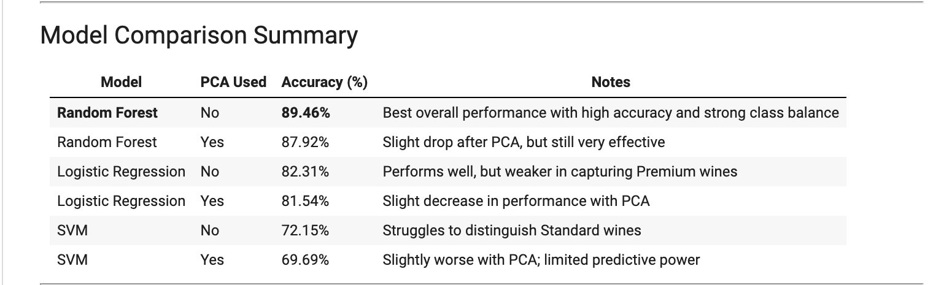
• Best model: Random Forest (Accuracy: 89.46%)
• Premium wines harder to predict due to class imbalance
• PCA models performed slightly worse
• Metrics used: Accuracy, Precision, Recall, F1-Score
Model Evaluation
Notes:
After training and testing all the models, Random Forest without PCA came out on top, achieving about 89.5% accuracy.
Predicting Premium wines was more challenging due to class imbalance, but Random Forest still handled it better than the other models. We evaluated each model using accuracy, precision, recall, and F1-score to make sure our results were reliable across both classes, not just overall.

Slide 16

Next on the menu: Visualization in Tableau
• Coming up: Feature impact visualizations
• Correlation matrix, class predictions, and wine-type quality breakdown
Notes:
Now that we’ve validated our model, we’ll move on to visualizing our results in Tableau. We’ll explore how features like alcohol, pH, and density influence wine quality across red and white wines.

Slide 17
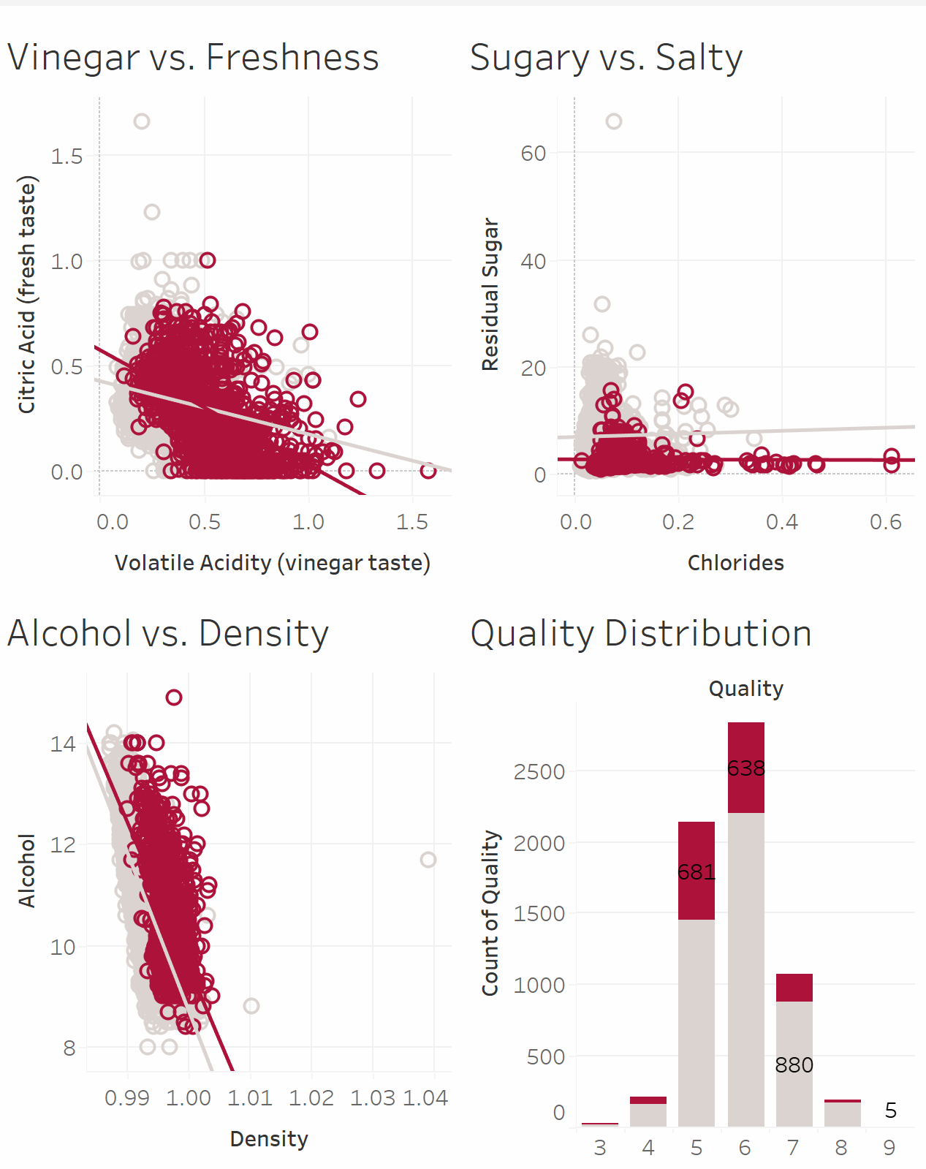
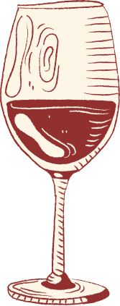
Tableau
.
Wine Quality Prediction Visuals - Team 3 Final Project | Tableau Public
Notes:
Preview of some of the visuals we created on Tableu. To get the full story check out the Tableau link.

Slide 18
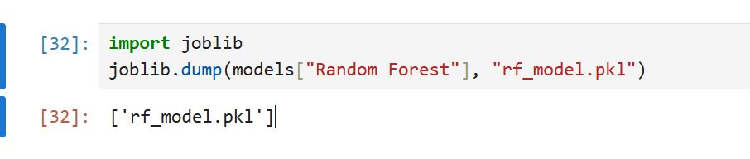
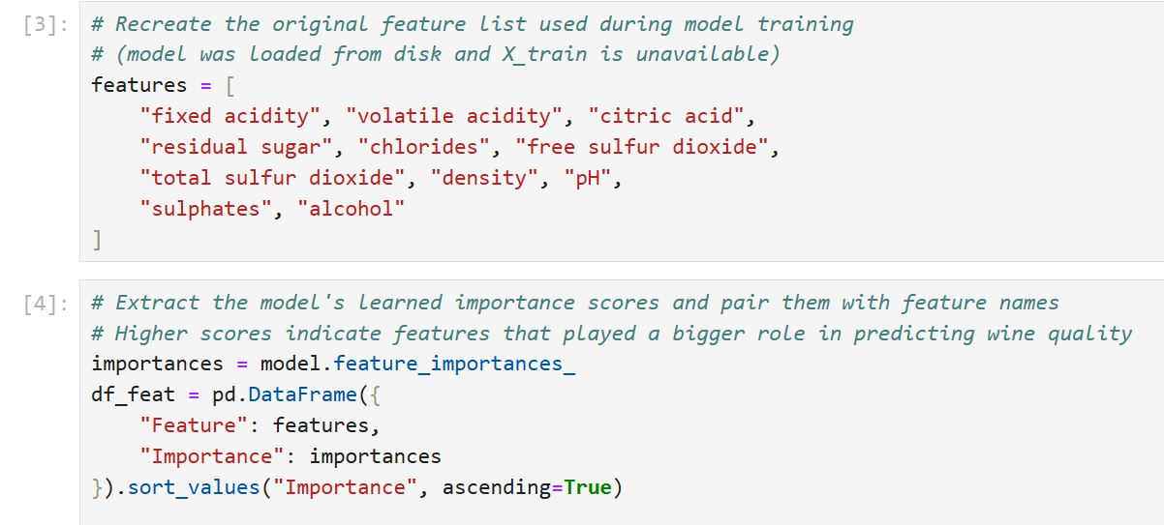
Feature Importances:
What the random forest prioritized
This step saved our RF model so we could later interpret what it learned—without retraining it.
• Feature importances show how much each variable contributes to making accurate predictions.
• In a Random Forest, features that split the data more cleanly are ranked higher.
• Think of it like asking the model, “Which ingredients matter most when choosing a premium wine?
• These scores aren’t based on correlation—they reflect how useful each feature was during training.
• It gives us a peek into the model’s “thought process,” not just its output.

Slide 19
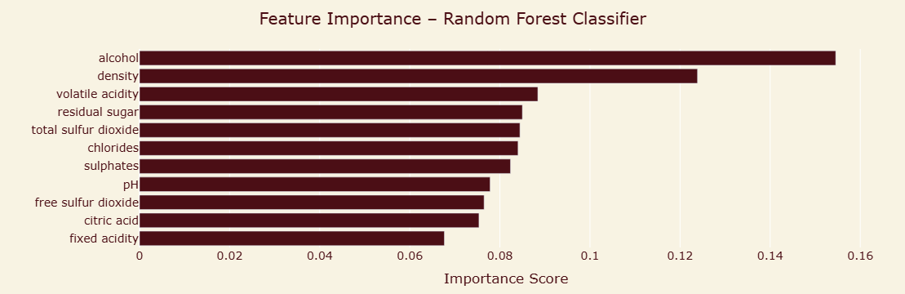
How THE MODEL WEIGHED THE CHEMISTRY
Notes:
These aren’t averages or trends—this reflects how the model made its decisions

Slide 20

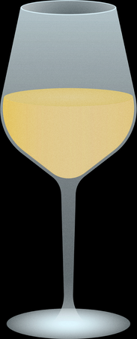


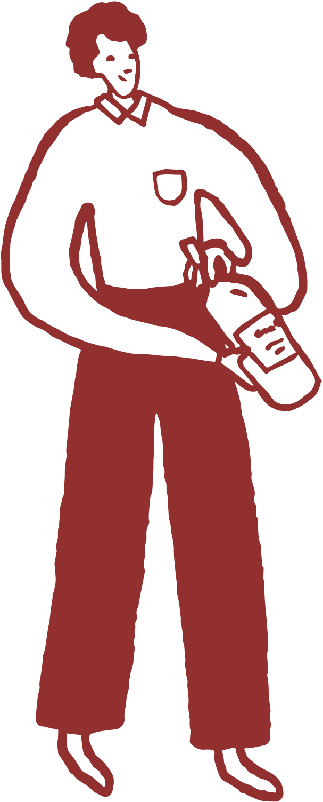




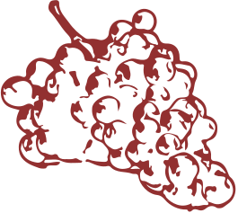
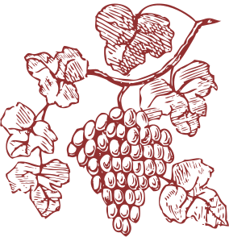
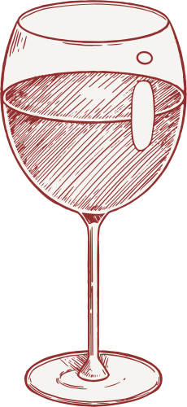
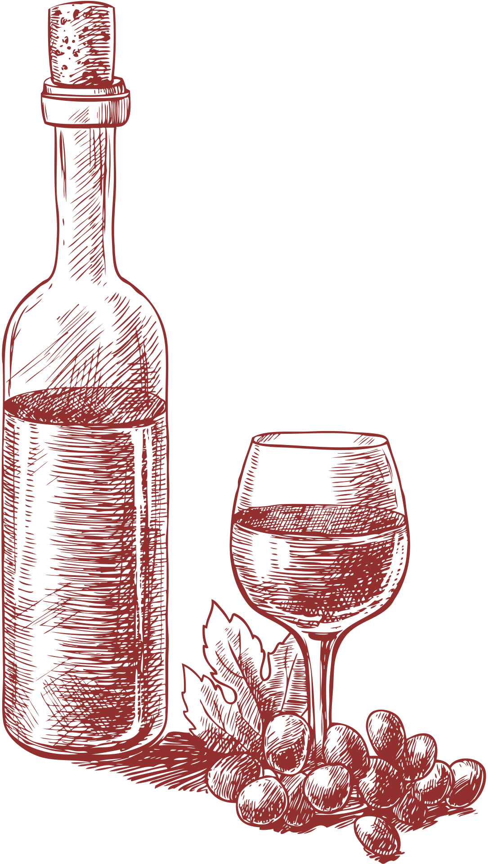
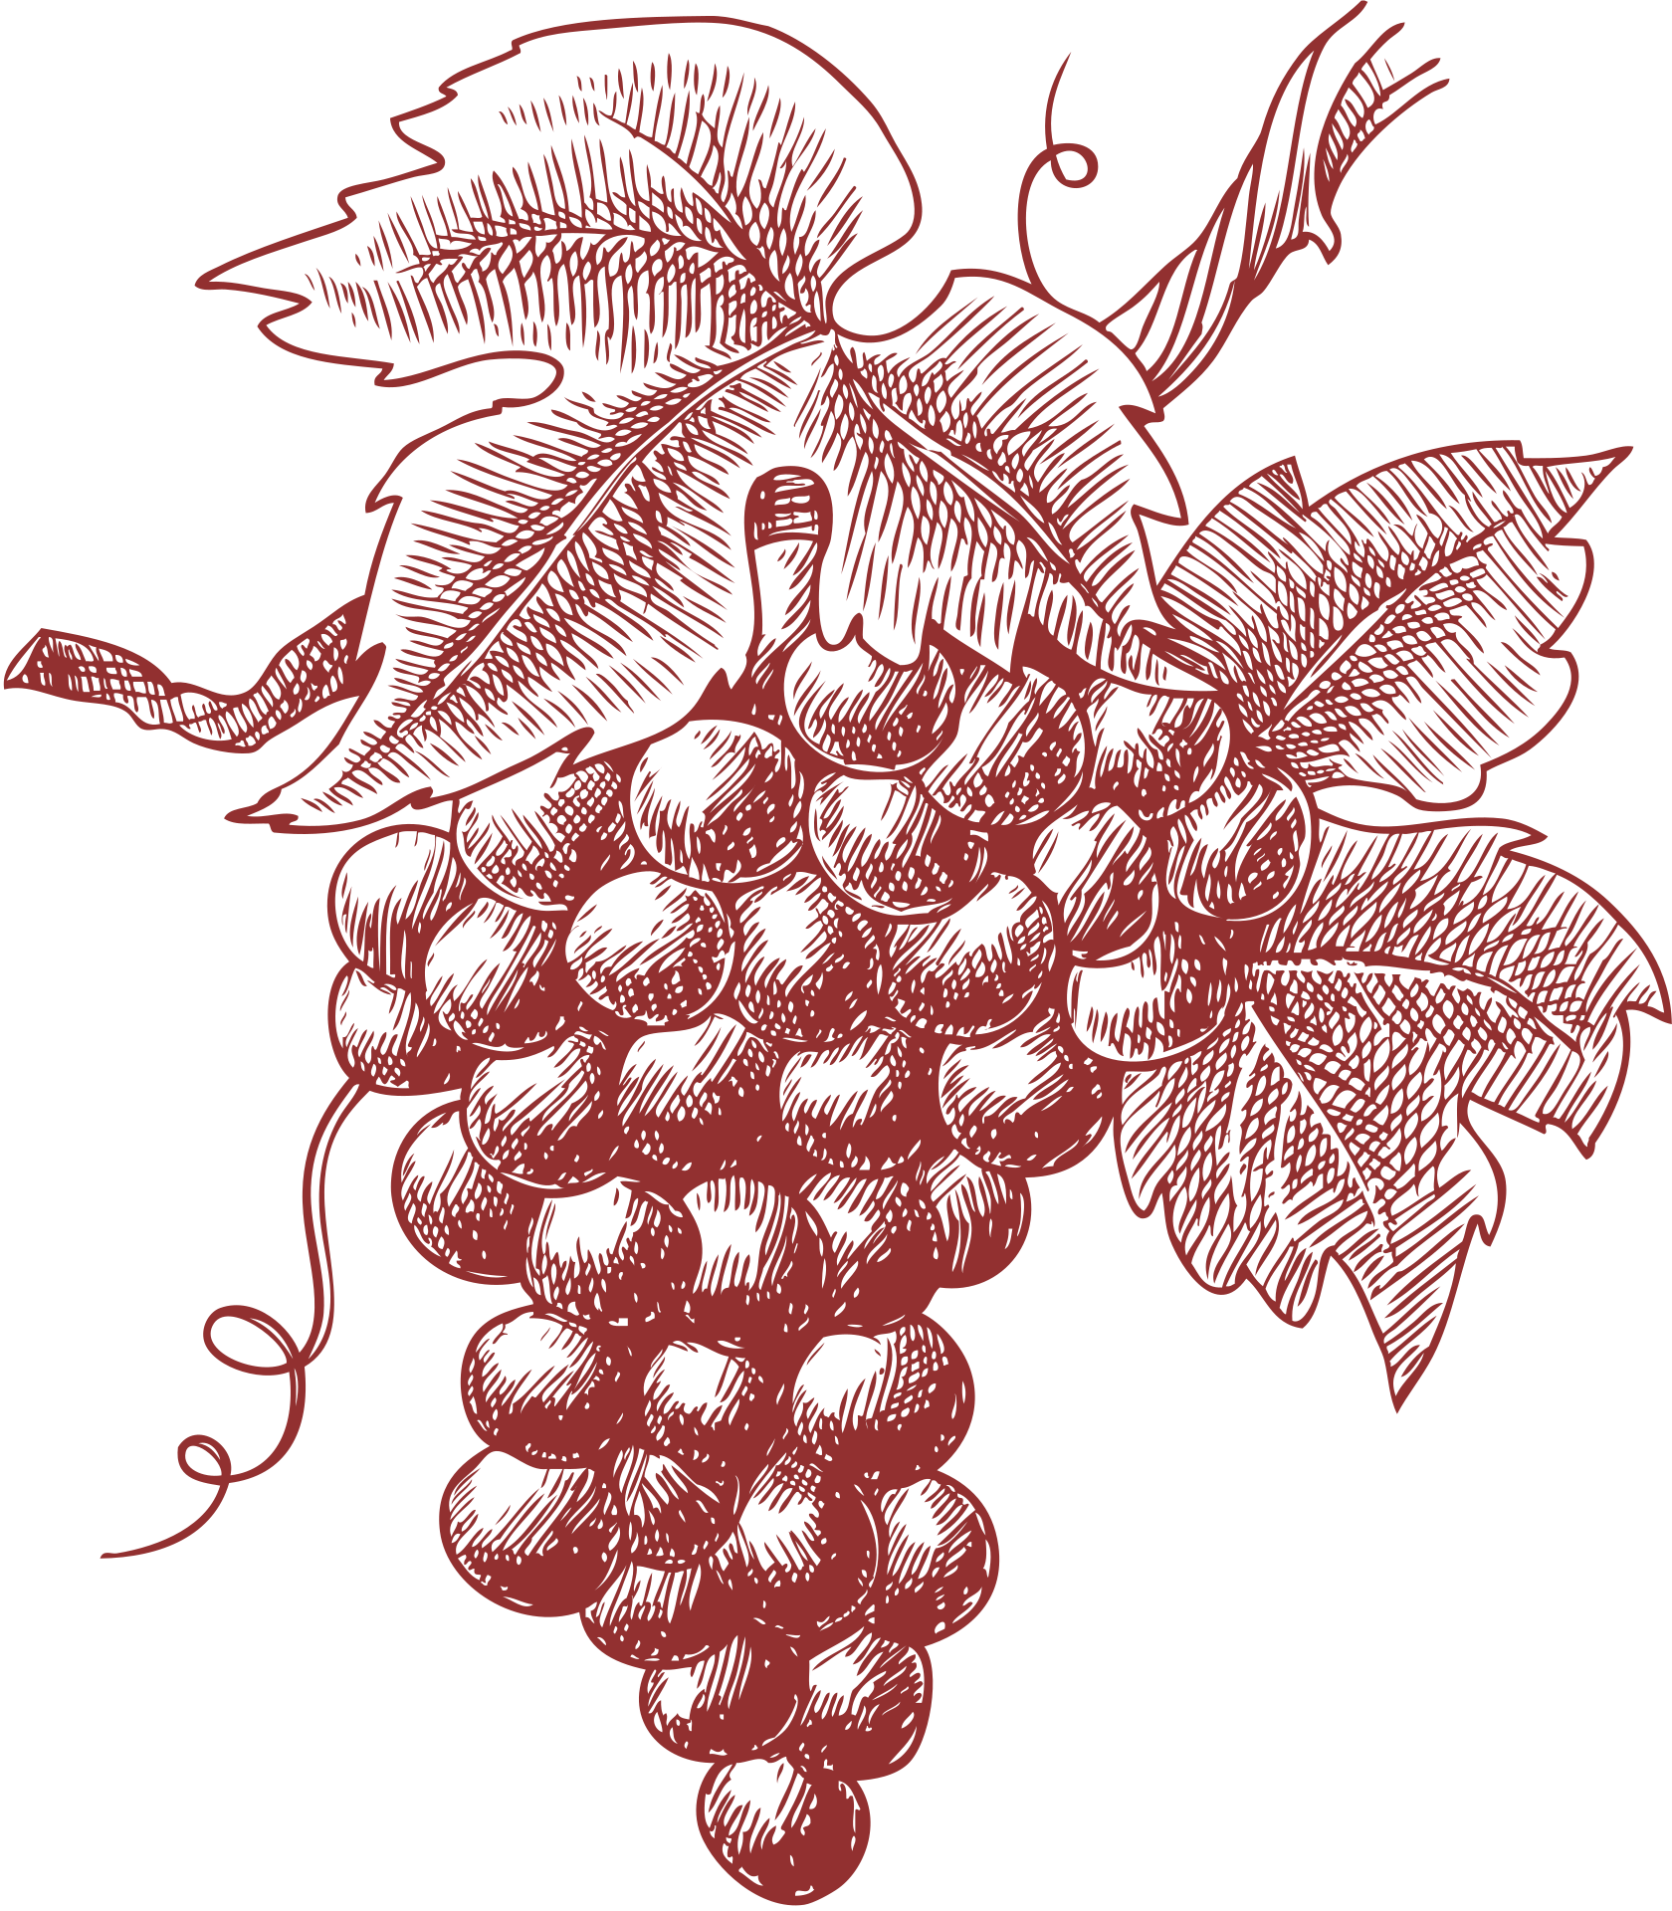

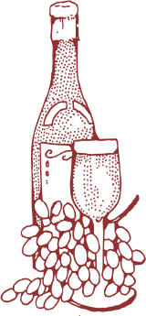
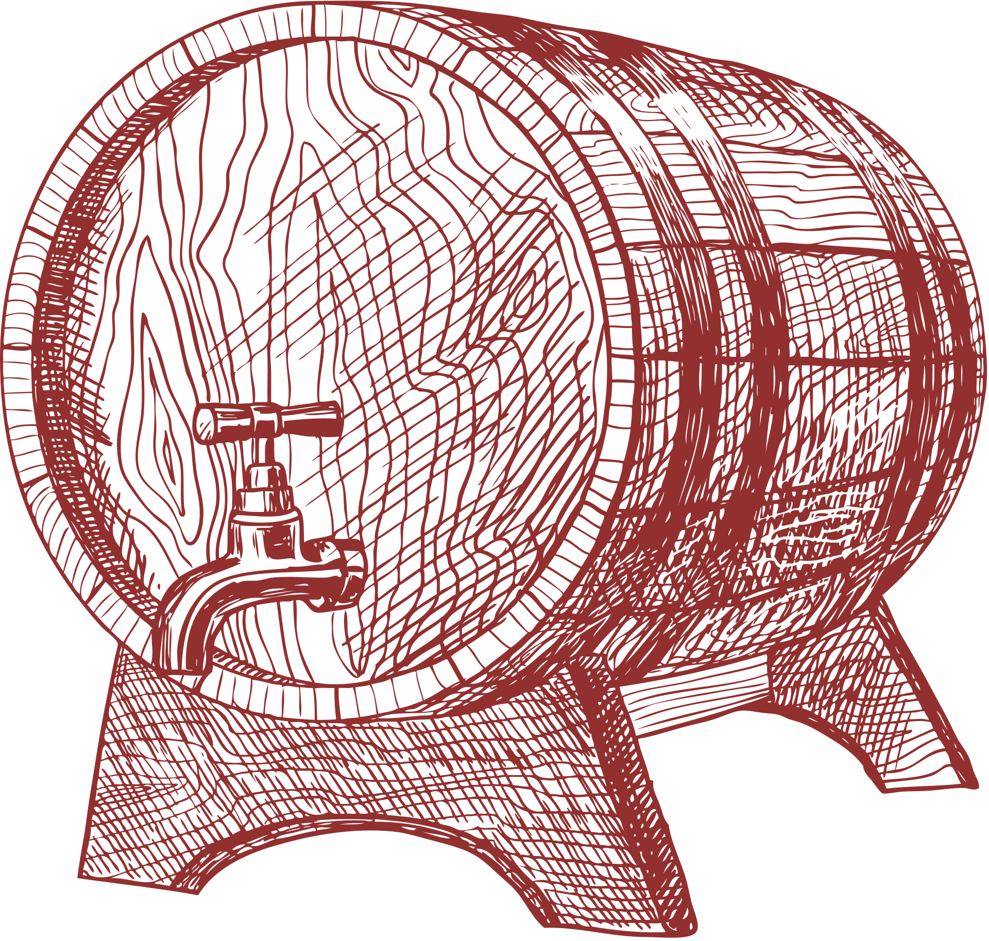
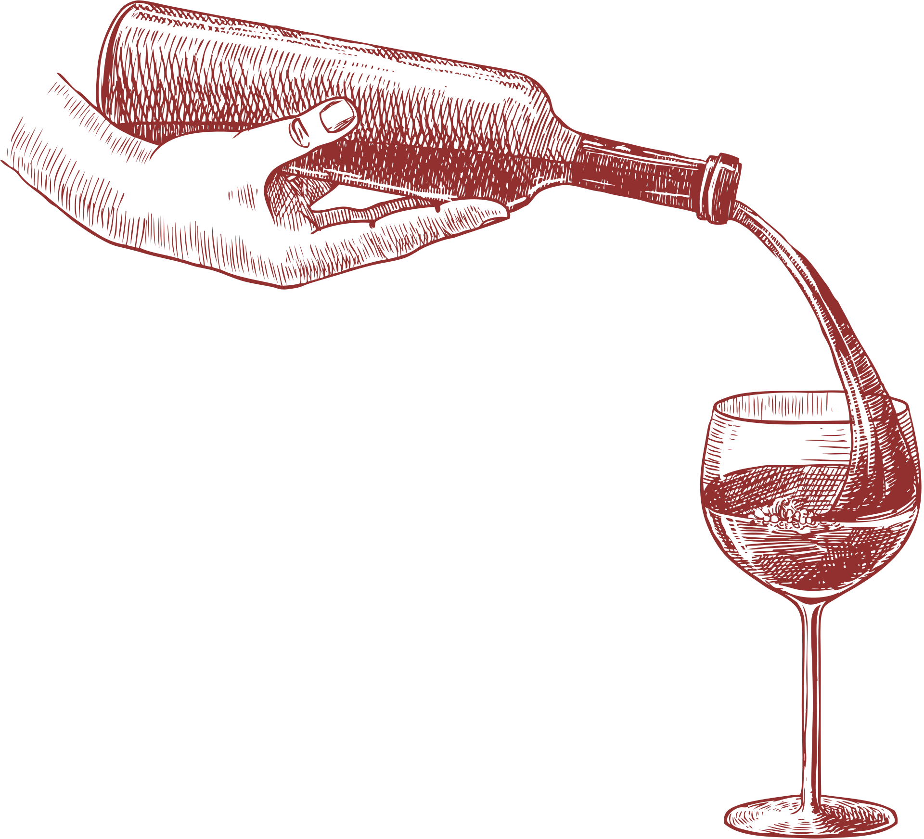

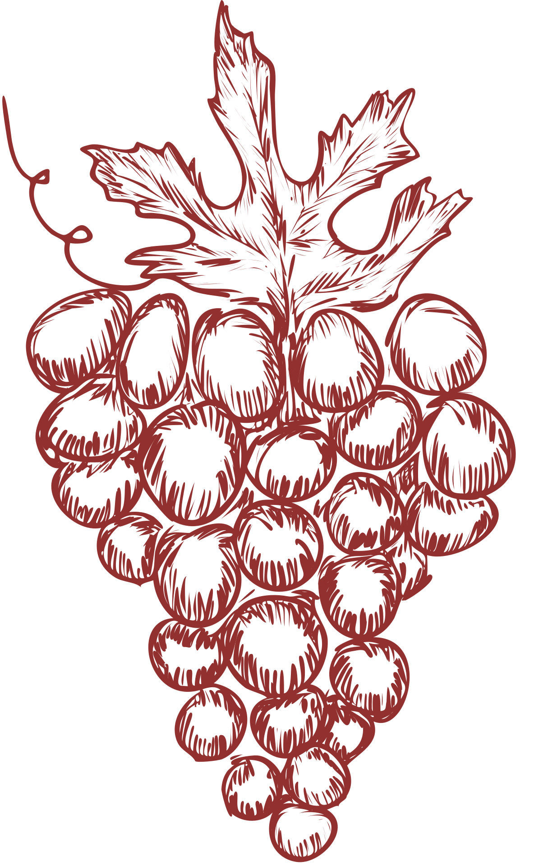






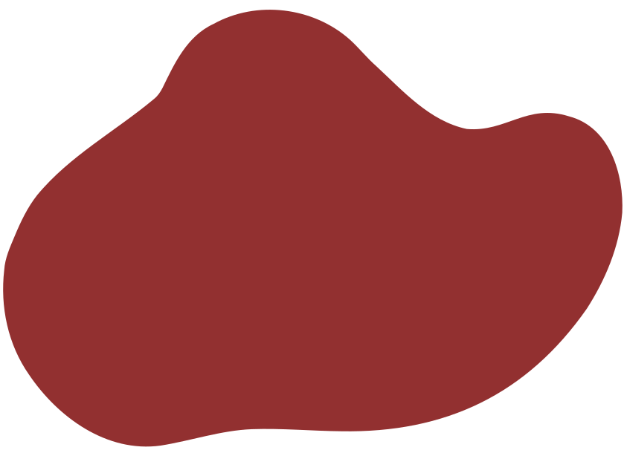
our
sources
https://github.com/alvamag/Team3_Project4/tree/77dc83f774b1955d825d0d8aa0b455e2ea1c4880/Resources

Slide 21

Contact Us
123 Virtual Street
123-456-7890
bestwines@datavinetwelve.com
datavine12
datavinetwelve.com

